Slide 1
Delivery By Value (DBV) Extraction - Financial Application
Mufaddal haidermota

Slide 2
Problem Statement
To generate a complete DBV report along with graphical representations of yearly, quarterly, monthly trends seen in the data and technical/business suggestions based on the present and forecasted details for a financial application.
The report should also identify and present trends and patterns in the data and showcase emerging customer behavior patterns.
The raw data should be used to create a presentable content which can be used by business/sales team for capacity planning and application marketing.

Slide 3
Solution
The solution will extract volume statistics such as Total number of transactions, sales generated, etc. for a particular period.
The produced visualizations in Power BI will highlight the key KPIs, sales trend and help the stakeholders to understand customer lifecycle pattern with an eye on future predications.
The solution will also help in identifying stocks/products that are in demand and that which are sitting on shelf/warehouse for a long period of time.
The proposed solution will assist the business and sales team to plan for future requirements by only producing required resources and help in target marketing.

Slide 4
Business Value
Its an end-to-end solution using multiple technologies on Azure (cloud platform) to tackle the issue of delivering by value to all our stakeholders and customers.
Our Preposition stands on 4 pillars :
Development of Forecasting Model (Sales)
Development of Statistical/ML Models (Customer Segmentation, Anomaly Detection)
Designing of Visualization Elements
Discover areas of Financial Growth

Slide 5
Technologies
Cloud Platform – Microsoft Azure
Data Storage – SQL Server
Data Workflow Tool – Azure Data Factory
Analysis and Model Building - Python
BI Tool (Analytics and Visualization) – Power BI

Slide 6
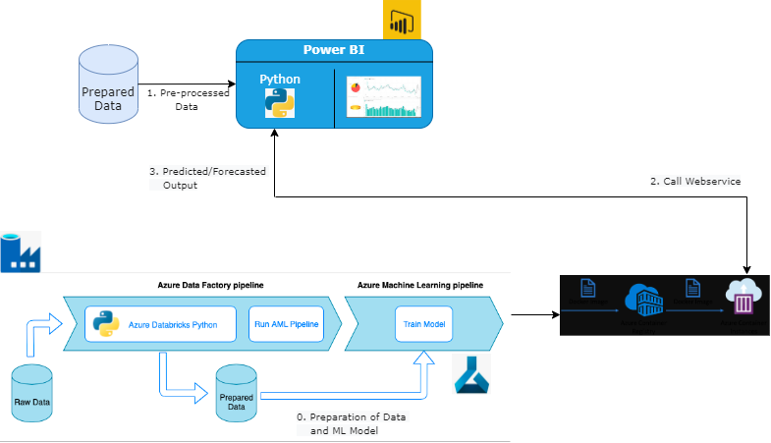
Technical Design

